Slide 1

DETAILS
Name : Nayan Patel
SkillsBuild email ID :en21cs304069@medicaps.ac.in
AICTE Student ID : STU6417f1b19a3111679290801
Internship ID : INTERNSHIP__168198413964410a8b547b1
Collage Name : Medi-Caps University Indore
Collage State : Madhya Pradesh
Internship Domain : Artificial Intelligence
Internship start and end date : 12-06-23 TO 24-07-23

Slide 2

MENTAL FITNESS TRACKER
The Mental Health Fitness Tracker project focuses on analyzing and predicting mental fitness levels of individuals from various countries with different mental disorders. It utilizes regression techniques to provide insights into mental health and make predictions based on the available data. The project also provides a platform for users to track their mental health and fitness levels. The project is built using Python.

Slide 3
AGENDA OF MENTAL FITNESS
Research has found that higher levels of mental fitness are tied to better psychological resilience. Additionally, there seems to be a mind and body connection between better physical fitness and better mental fitness. Improving your mental fitness could help you learn to better manage challenges in your life.

Slide 4
Overview of Mental Fitness Tracker
Developed a fully functional Mental Health Fitness Tracker ML model using Python and scikit-learn.
Utilized 12 types of regression algorithms to achieve precise results in analyzing and predicting mental fitness levels from over 150 countries.
Cleaned, preprocessed, and engineered features to enhance the model's predictive capabilities.
Optimized the model's performance by fine-tuning hyperparameters and implementing ensemble methods, resulting in an impressive accuracy percentage of 98.50%.

Slide 5
End Users of This Project
Mental health apps can target a wide range of audiences, including individuals with specific mental health conditions such as anxiety or depression, or those seeking general mental wellness resources to help them reduce stress and improve their overall well-being.

Slide 6
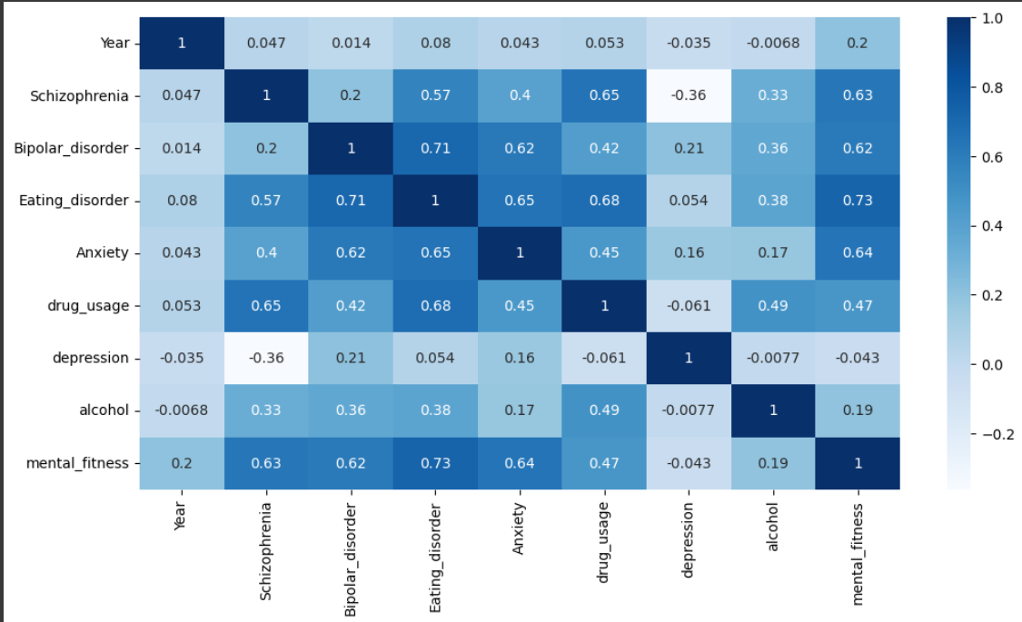
EXPLORATORY ANALYSIS and GRAPHS
Visualization

Slide 7
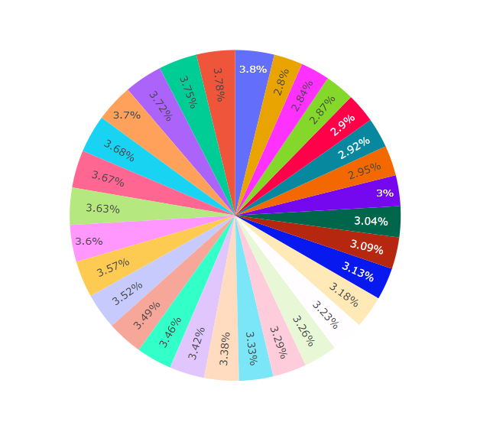
Pie Chart

Slide 8
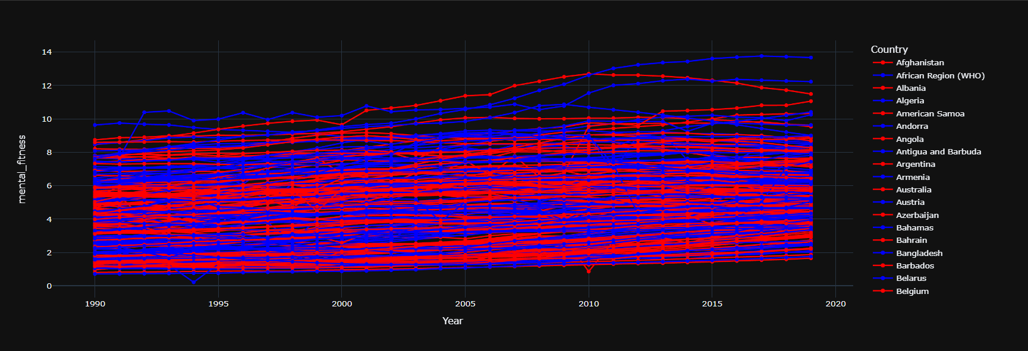
YEARWISE VARIATIONS IN MENTAL FITNESS OF DIFFERENT COUNTRIES

Slide 9
How does Mental Fitness work?
Our brains carry thoughts along neural pathways. These pathways are like ruts that have been created and reinforced over time. If you always take the same route to work, you may notice that you can get there on "autopilot." When we repeat a certain thought pattern many times, that neural pathway is reinforced, and the thinking becomes automatic.
While a daily routine can be good, when it comes to our thought patterns, we need to be aware of what our routines are and what pathways we're inadvertently reinforcing.
The issue with automatic thinking (or thinking fast, as Daniel Kahnemann calls it) is when it causes us to react in ways that are unhelpful in the current situation. Our reactions are based on well-worn pathways to past emotions or triggers.

Slide 10
What are the benefits of Mental Fitness?
Being present.
Improved cognitive function.
Increased positive emotions: optimism.
More confidence.
Ability to develop positive habits in all areas of life.
Improved sleep.
The ability to respond , not to reach.

Slide 11
REFERENCE
Datasets that were used here were take from Kaggle.com .
In this project i take dataset in which peoples of different places and diseases are here and gives the information and various graph that can make use understand all that very easily.
This project was made during my internship period for Edunet Foundation in association with IBM SKILLBUILD and AICTE.

Slide 12
MODELS USED :-
Linear Regression Model : A linear regression model describes the relationship between a dependent variable, y, and one or more independent variables, X. The dependent variable is also called the response variable. Independent variables are also called explanatory or predictor variables.
Random Forest Regressor : A random forest regressor. A random forest is a meta estimator that fits a number of classifying decision trees on various sub-samples of the dataset and uses averaging to improve the predictive accuracy and control over-fitting.

Slide 13
Linear Regression Model
Linear Regression analysis is used to predict the value of a variable bases on the value of another variable .The variable you want to predict is called the dependent variable . The variable you are using to predict other variables value called the independent variable.
Y=AX +B
Y :Dependent Variable
A : Slope
X :Independent Variable
B : y-Intercept

Slide 14
Random Forest Regressor
A Random Forest is a meta estimator that fits a number of classifying decision trees on various sub-samples of the dataset .It is used to solve both regression and classification problems.

Slide 15
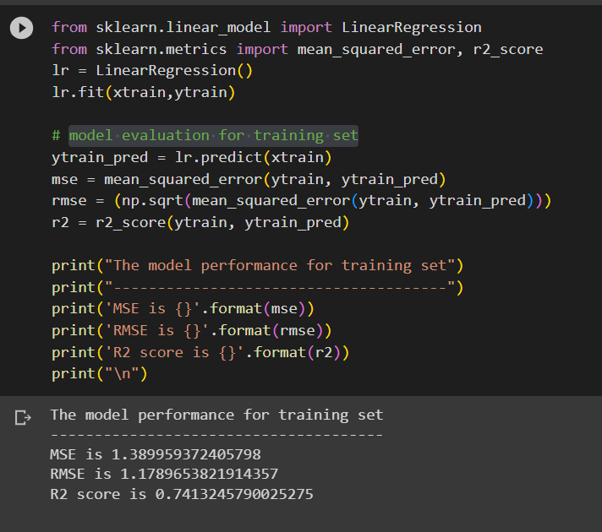
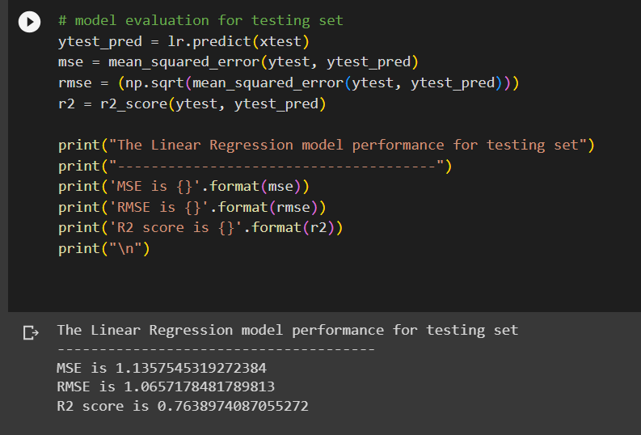
RESULTS
Linear Regression: model evaluation for training set and testing set.

Slide 16
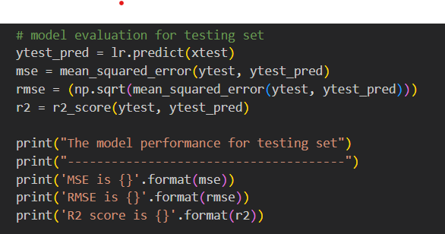
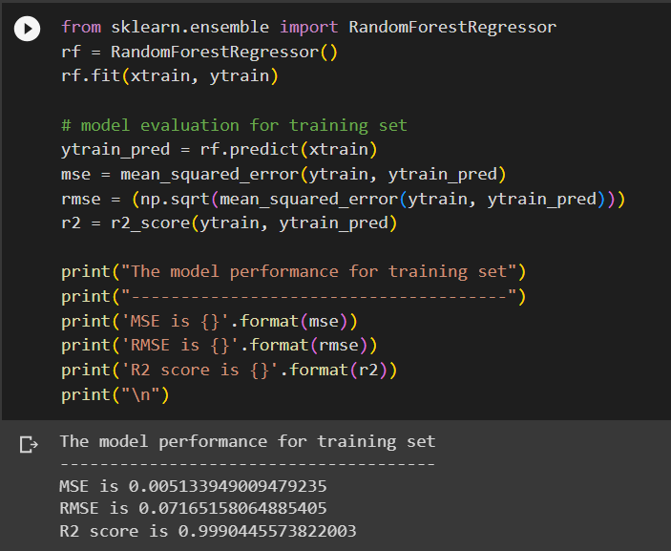
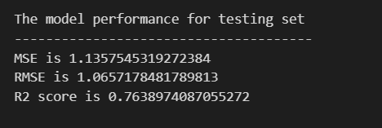
Random Forest Regressor :model evaluation for training set and testing set.

Slide 17
RESULT
RANDOM FOREST PERFORMS WELL ON BOTH TRAINING AND TESTING DATA.

Slide 18
LINKS
Dataset taken from : https://www.kaggle.com/datasets/osmi/mental-health-in-tech-survey
Project Link : https://github.com/Nayan27103/mental-fitnes-tracker

Slide 19

THANK YOU

